Slide 1
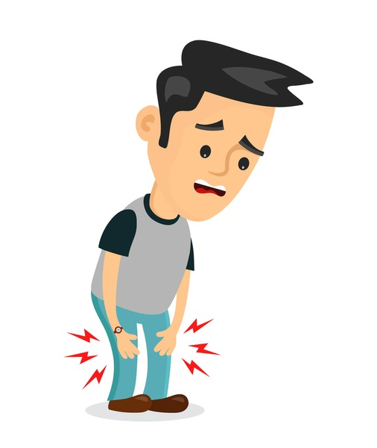
ARTHRITIS
What kind do I have?

Slide 2


Maura A Calio, MA, RN
Community Health Educator
St. Francis Hospital DeMatteis Center

Slide 3
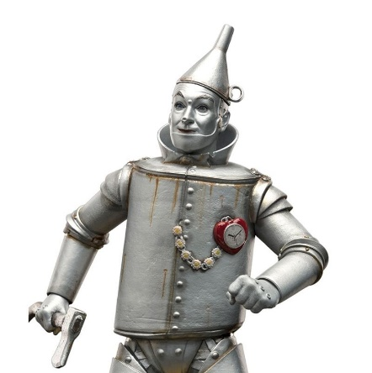
Why are my joints so stiff?
As you age, your cartilage—the spongy material that protects the ends of your bones—begins to dry out and stiffen.
Your body also makes less synovial fluid, the stuff that acts like oil to keep your joints moving smoothly.
The result: your joints may not move as freely as they used to.
The best thing you can do is KEEP MOVING. Synovial fluid needs movement to keep your joints loose.

Slide 4
What is Arthritis?
Arthritis is the swelling and tenderness of one or more joints.
Main symptoms: joint pain and stiffness, worsens with age.

Slide 5
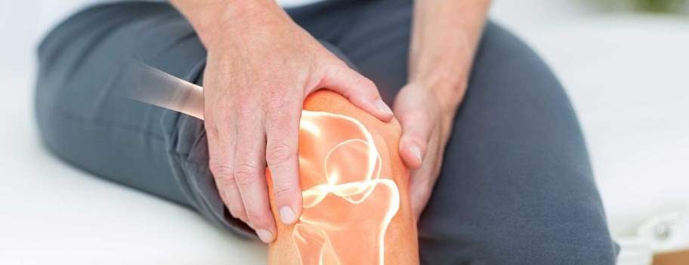
Types of Arthritis
Osteoarthritis (OA)~most common type
Rheumatoid arthritis (RA)
Psoriatic arthritis
Gout
Several other types

Slide 6
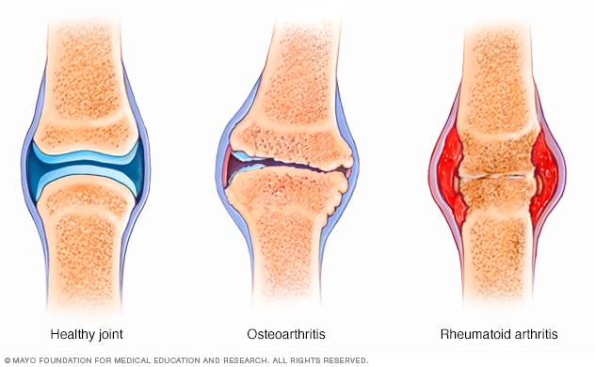
What’s happening in there?

Slide 7
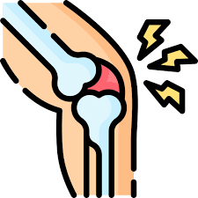
Goals of Treatment for all types of arthritis
Reduce symptoms
Slow progression of disease
Improve quality of life

Slide 8
What happens in Osteoarthritis? (OA)
“Wear and Tear”
Degenerative joint disease, in which tissues in the joint break down over time
Most common type, more common in older people
Symptoms: joint pain, then stiffness after rest or inactivity
Most commonly affected joints: hands, knees, hips, neck, lower back
Varies in severity: may be mild, and for others causes significant pain and disability
Usually develops gradually, but in some it can worsen quickly

Slide 9
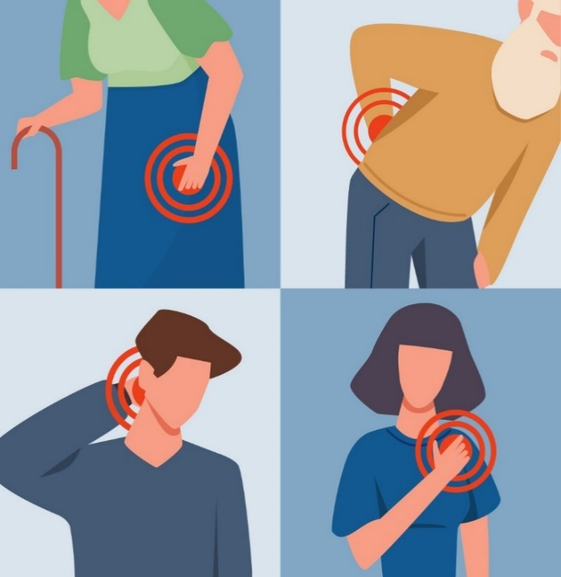
Common joints affected by Osteoarthritis
Small joints of the fingers
Knees
Hips
Lower back
Neck

Slide 10
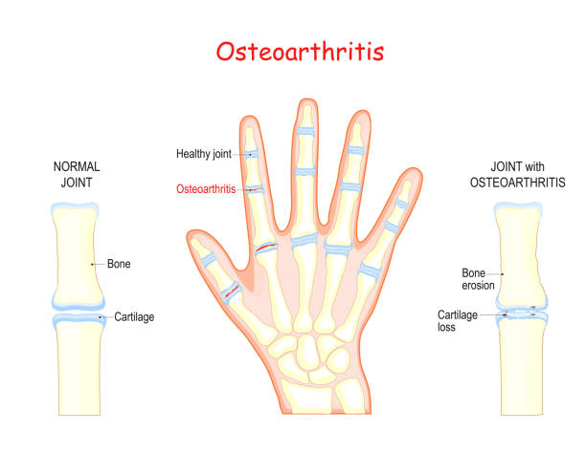
Hands

Slide 11
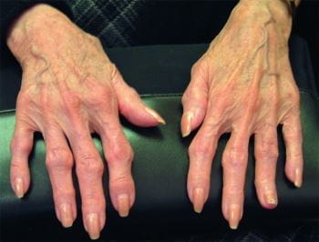

Slide 12
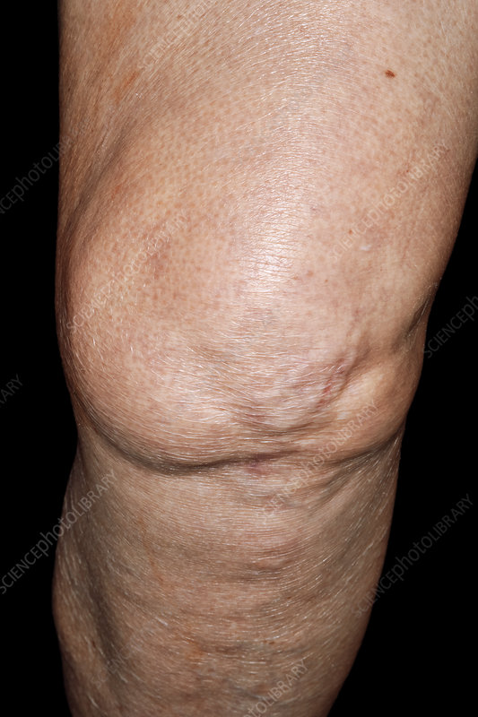

Slide 13
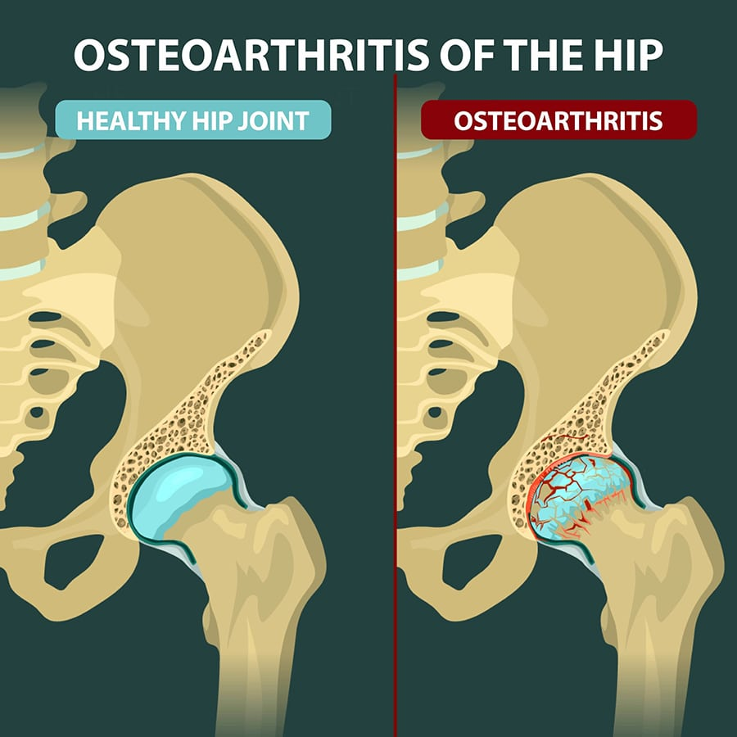

Slide 14
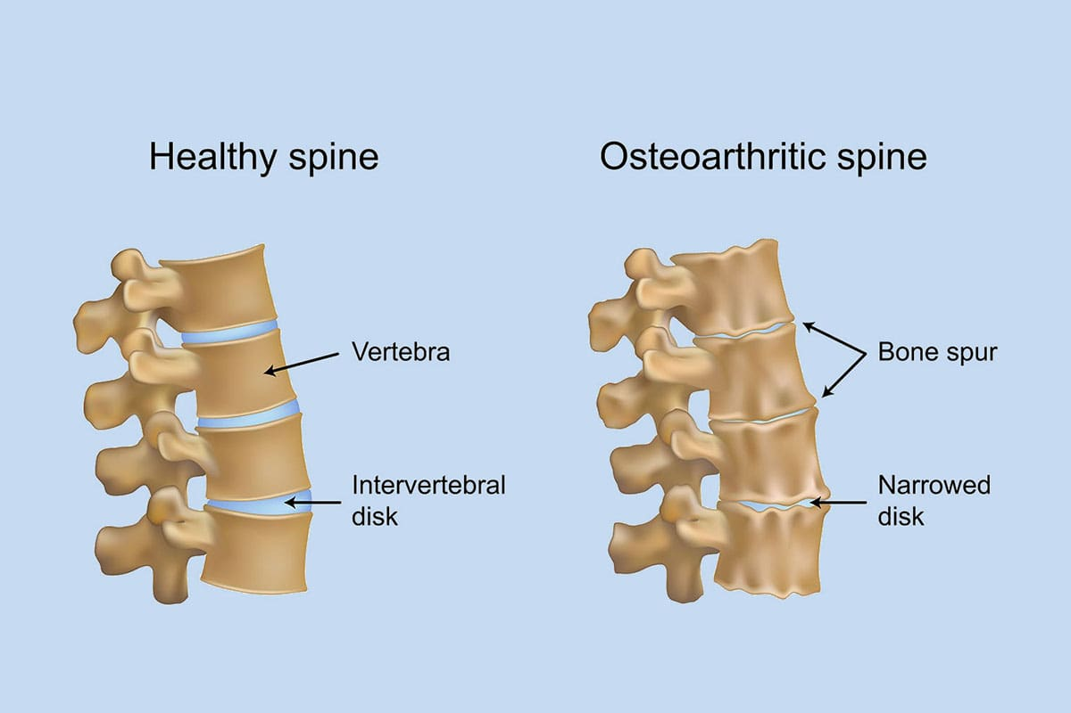
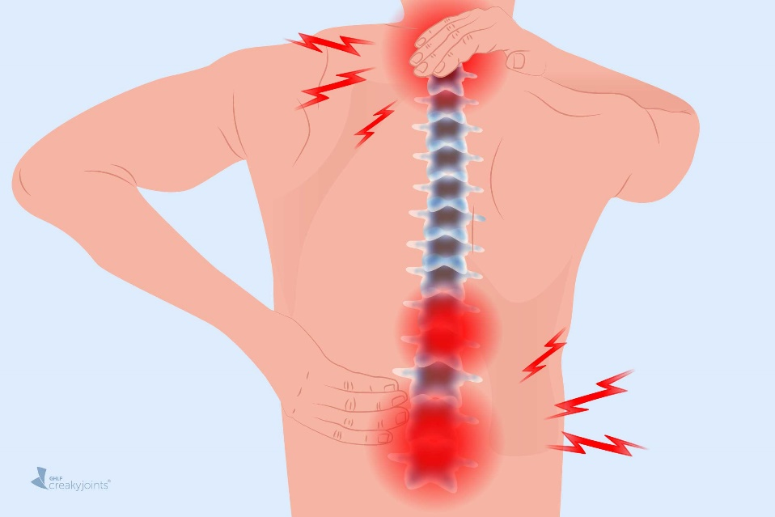

Slide 15
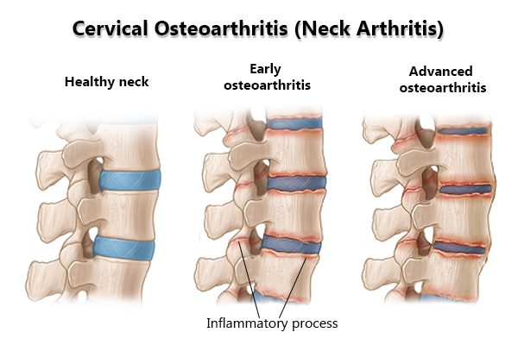

Slide 16

Risk Factors for Osteoarthritis (OA)
Previous joint injury or joint overuse
Obesity—extra weight adds additional stress on weight-bearing joints
Age—risk of OA increases with age
Genetics—people with relatives with OA are more likely to develop it themselves
Gender—women (esp over 50) more likely to develop OA than men

Slide 17
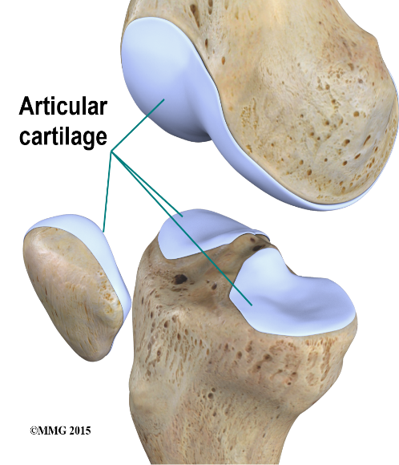
What happens?
Healthy Joint
Cartilage (firm rubbery material) covers end of each bone
Cartilage acts as a cushion between bones, allows for smooth, gliding surface

Slide 18
In Osteoarthritis, cartilage breaks down, causing pain, swelling, and problems using the joint
As cartilage breaks down, changes may occur in the underlying bone.
The membrane lining the joint (synovium) may also become inflamed

Slide 19
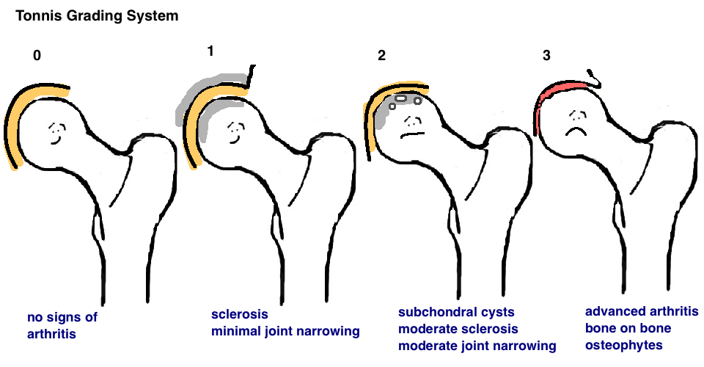
Progression of arthritis

Slide 20
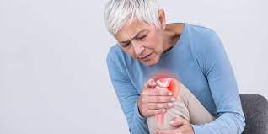
Symptoms of Osteoarthritis
Pain, aching, or tenderness around a joint
Stiffness that makes it difficult to move the joint
Swelling around the joint
Clicking or cracking sound when moving joint

Slide 21

Diagnosis
Physical exam—looking for swelling, redness and warmth
Lab tests—to determine the type of arthritis you have (blood tests, joint fluid, urine)
Imaging: x-rays, CT (bone and soft tissues), MRI (cartilage, tendons, ligaments)
Ultrasound—might be used to take sample of fluid, or for injecting medications into joint

Slide 22
Treatment of OA
NSAIDS, oral steroids
Heat and cold
Topical gels or cream: NSAID, menthol, capsaicin
Joint injections: steroids (limited number), gel shots (adds lubrication)
Physical therapy
Sometimes braces or splints, canes, walkers, raised toilet seat

Slide 23
How do I slow down progression?
OA cannot be reversed, but to control its progression:
Weight loss—decreases burden on the joints
Physical activity—to maintain joint mobility
Avoid joint injury
Avoid jobs that require repetitive movement or heavy loading of joints

Slide 24
How do weight, obesity, and BMI affect the hips and knees?
The joints in our legs carry the weight of our bodies every day when we do our normal activities, such as walking, standing, running, and climbing.
Because of our anatomy, the forces experienced across the joint surfaces inside our hips and knees can be more than 7 times our body weight.
The more weight we carry around, whether it is muscle or fat, the greater the load on our hips and knees.

Slide 25
How do weight, obesity, and BMI affect the hips and knees?
Heavier people are more likely to require total hip and knee replacements than patients with normal BMIs.
Risk increases as your BMI increases.
Losing weight, or keeping your weight at a healthy level, can help improve hip and knee pain symptoms, as well as help prevent or delay a hip or knee replacement.

Slide 26
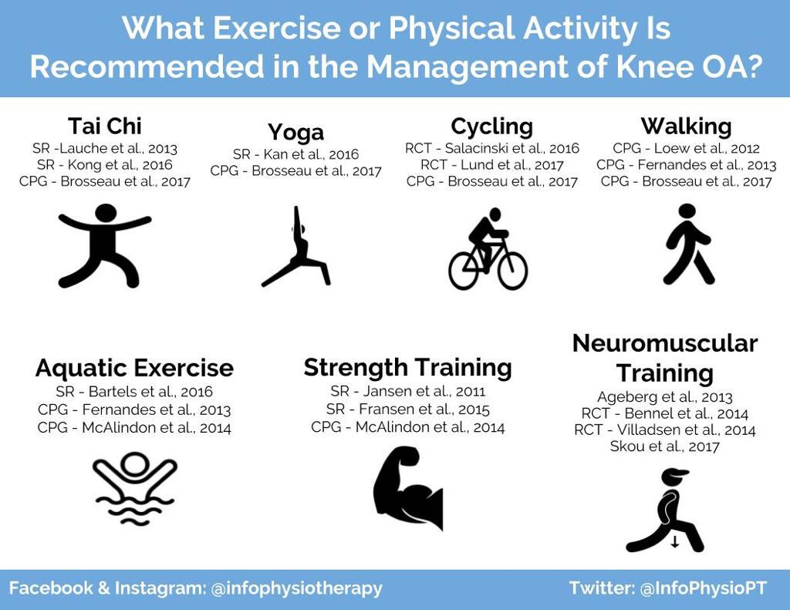

Slide 27
When is it time to have surgery?
You have exhausted all treatment options
You experience continual pain that interferes with daily life
You are healthy enough to undergo surgery and aggressive physical rehabilitation

Slide 28
How can I reduce my risk of having a complication from hip or knee replacement?
Healthy weight loss, while not easy, has many health benefits in addition to making surgery less risky
Weight loss may prevent or delay the need for joint replacement.
Prehab—water and land-based therapy, flexibility and aerobic exercises

Slide 29
How can I reduce my risk of having a complication from hip or knee replacement?
Stop Smoking at least 6 weeks prior to surgery (smokers have 1.5-3x risk of complications)
Diabetes—bring under good control (A1c under 7)

Slide 30
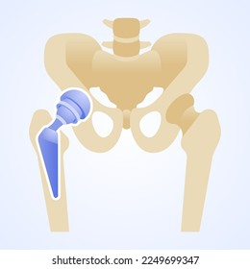
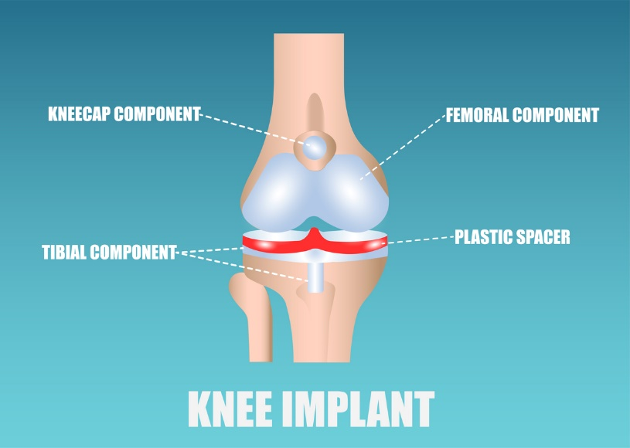
Hip replacement Knee replacement

Slide 31
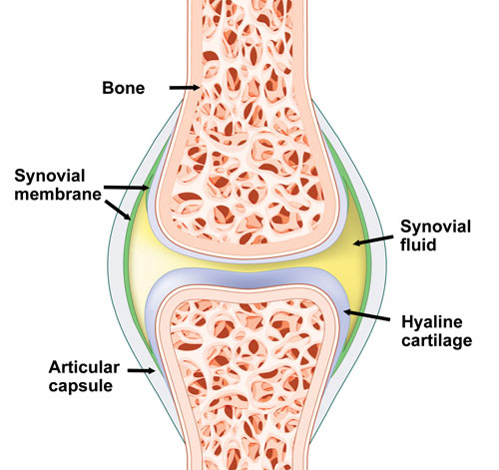
What Happens in Rheumatoid Arthritis (RA)?
The immune system attacks the lining of the joints (synovium)
Causes joint inflammation and pain
Commonly affects hands, knees, or ankles (both hands or both knees)
May also cause problems in other parts of the body (heart/lungs)
More women than men

Slide 32
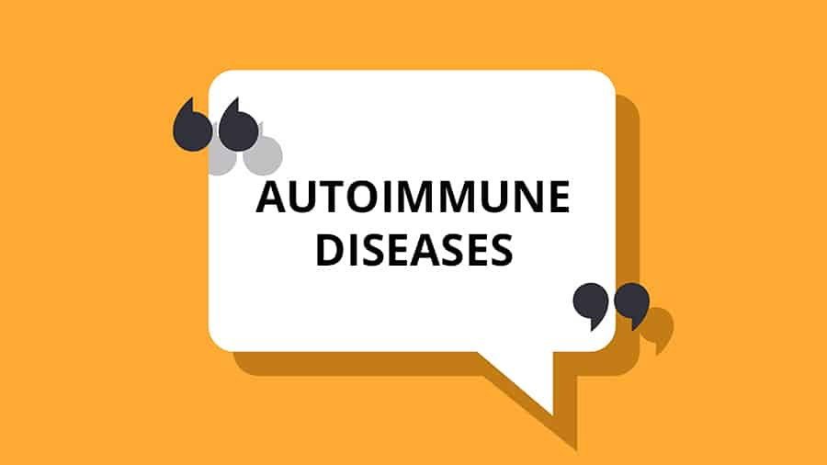
Why does this happen?
In healthy person, the immune system fights invaders like bacteria and viruses
With autoimmune disease, the immune system mistakes the body’s cells for foreign invaders and releases inflammatory chemicals that attack those cells
In RA, it attacks the lining around a joint that produces fluid that helps the joint move smoothly. The lining gets thicker and makes the joint area feel painful and look red and swollen.

Slide 33
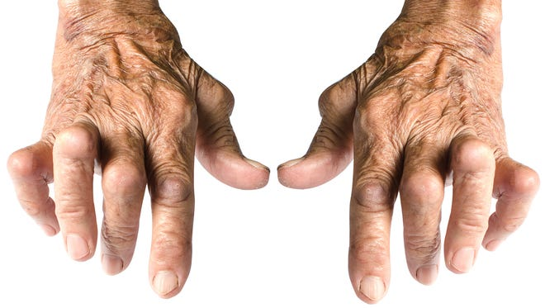
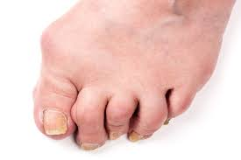
Joint Deformities

Slide 34

Proper Diagnosis
Essential to treat RA effectively
History: Joint symptoms: Do they come and go? What makes them better? Family history of RA or other rheumatologic disease?
Exam: joint tenderness, swelling, warmth, limited movement, bumps under the skin, fever
Blood tests: ESR, CRP, RF
Imaging: looking for ends of bone wearing down

Slide 35
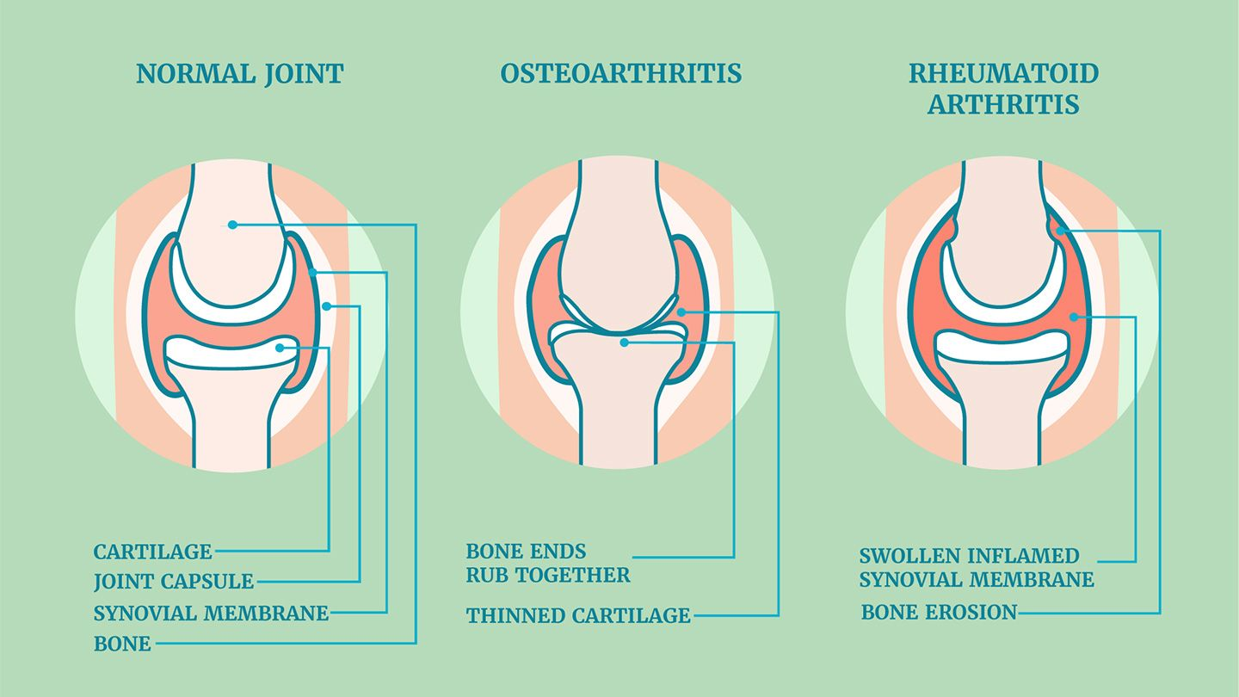

Slide 36
Current Strategy in Treatment
In the last few years, a shift in strategy toward the earlier institution of disease modifying drugs and the availability of new classes of medications have greatly improved patient outcomes
Optimal treatment of RA requires a comprehensive program that combines medical, social, and emotional support for the patient.
It is essential that the patient and the patient’s family be educated about the nature and course of the disease.

Slide 37
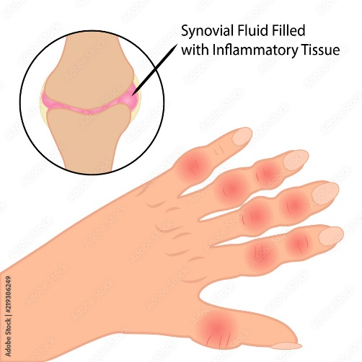
Treatment of RA
A Chronic Disorder
Goals:
To reduce inflammation and put disease into remission
Relieve symptoms
Prevent joint and organ damage
Improve function and overall wellbeing
Reduce long-term complications

Slide 38
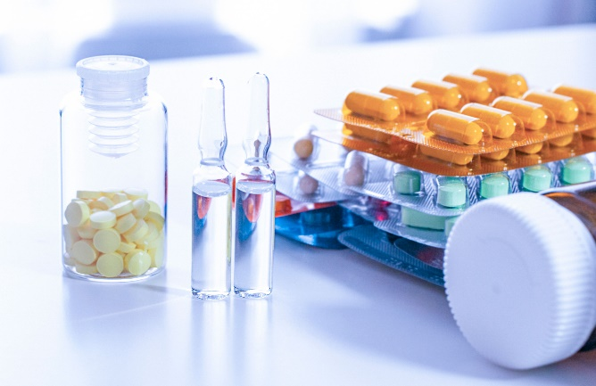
Medications Used to Treat RA
NSAIDS (Advil, Motrin, Aleve, Mobic, Arthrotec, Voltaren)
Corticosteroids (Prednisone, Medrol)
DMARD--Disease-modifying Anti-rheumatic Drugs (Methotrexate, Sulfasalazine, Plaquinil, Remicade, Rituxan, Imuran)

Slide 39
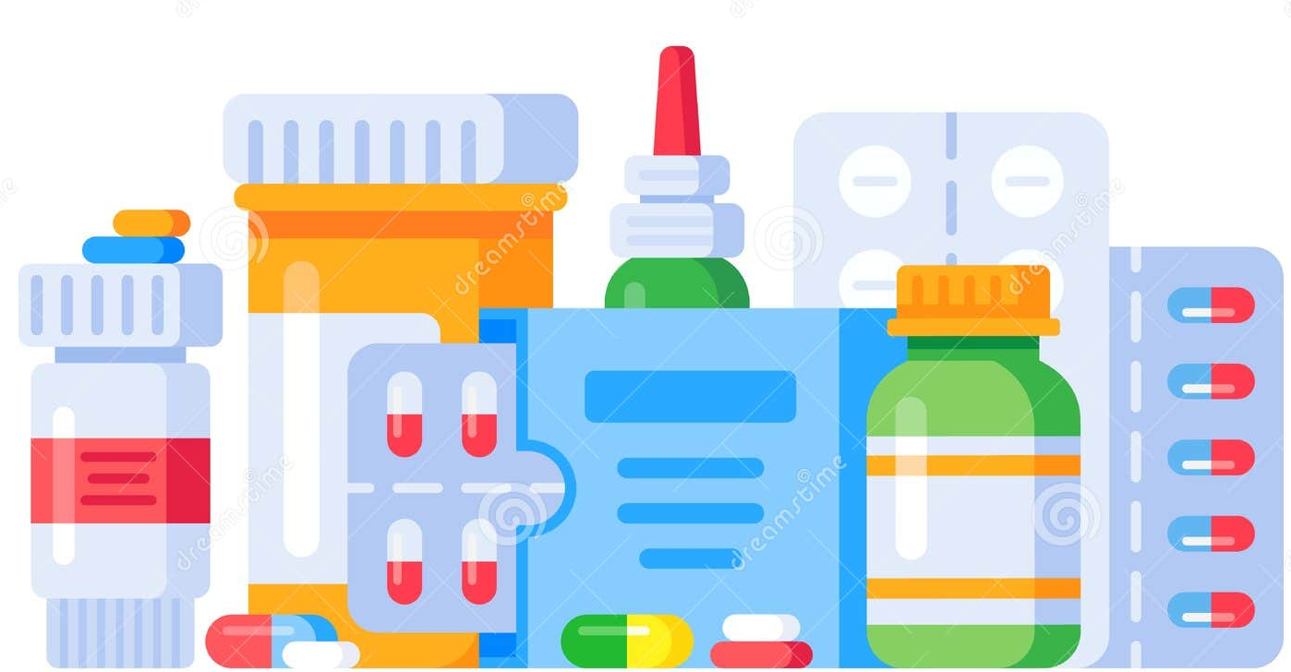
What do these medications do?
NSAIDS reduce acute inflammation, decrease pain, improve function—but do not change the course of disease or prevent joint destruction
Steroids—help reduce inflammation and promote immunoregulation, may be continued at low dose in addition to other meds
DMARDs—often are started as soon as diagnosis is confirmed because bony erosions frequently occur during the first 2 years of disease.

Slide 40
Health Effects of RA
Eyes—dryness, pain, inflammation, redness, sensitivity to light
Mouth—dryness and gum inflammation
Skin—rheumatoid nodules—small lumps over bony areas
Lungs—inflammation and scarring—can lead to shortness of breath and lung disease
Blood vessels—inflammation that can lead to damage in nerves, skin, other organs

Slide 41
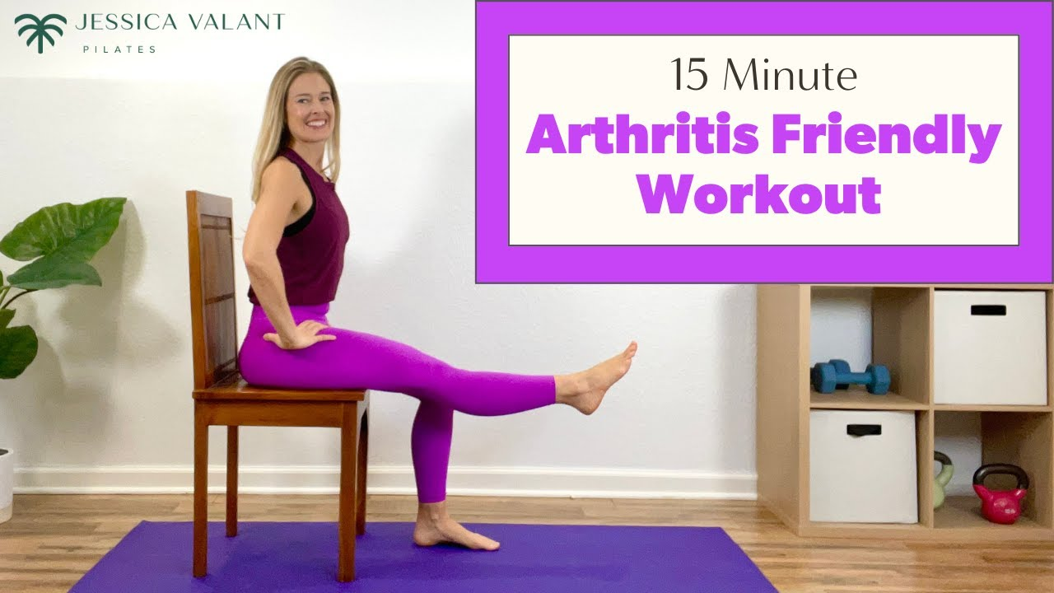
Arthritis and Exercise
One of the best nondrug therapies for arthritis pain
Benefits:
Keeps joints flexible and eases stiffness
Strong muscles keep joints stable
Slows deterioration of bone and cartilage
Improves bone strength
Maintains ability to do daily activities

Slide 42
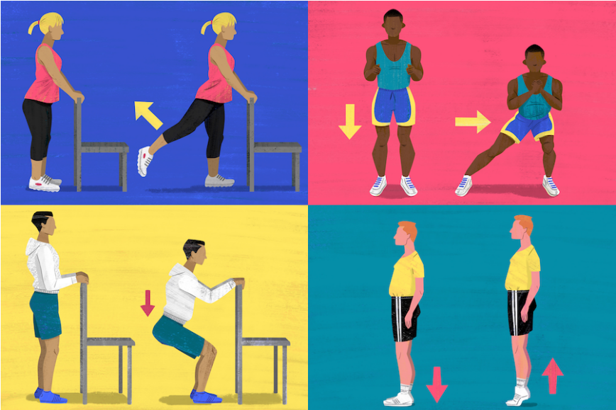
Always Warm up and Cool down!
No matter what exercise you’re doing, be sure to take 5-15 minutes to warm up before you begin your routine, and cool down afterwards to reduce your chance of injury
Do gentle stretches—don’t push so hard it hurts!

Slide 43
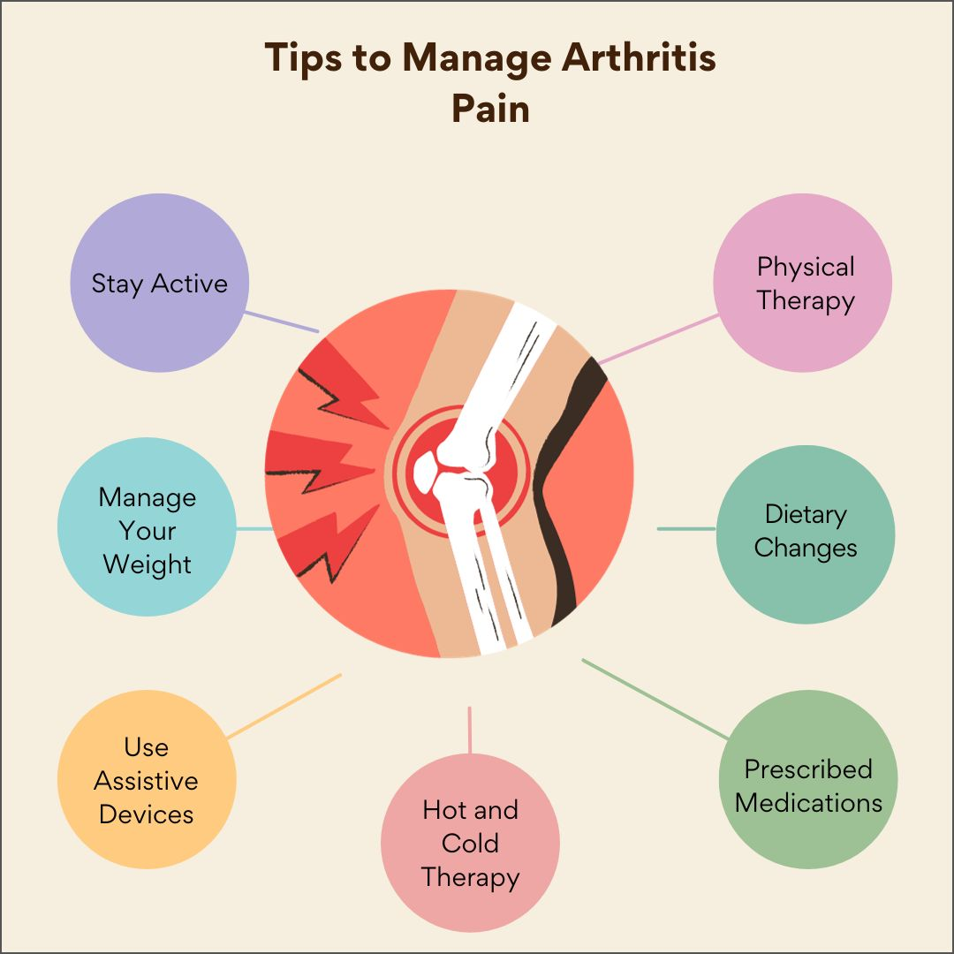
Summary

Slide 44

Questions?

